Slide 1


Canada
Notes:
Use WordArt to create the title.
Insert Picture - canada_flag.gif – resize with corner handles to maintain aspect ratio.

Slide 2






First Canadian Flags
St. George's Cross
fleur-de-lis
Royal Union flag
Union Jack
Red Ensign
Maple Leaf
Notes:
Insert Pictures - flag_st_georges_cross.gif, flag_old_fleur_d_l.gif, flag_royal_union.gif, union-jack.gif, flag_red_ensign.gif, canada_flag.gif – resize (keeping aspect ratio) and position on slide.
Insert Text Boxes to label each flag - St. George's Cross, fleur-de-lis, Royal Union flag, Union Jack, Red Ensign, Maple Leaf

Slide 3

The Coat of Arms
Canada’s Coat of Arms was officially proclaimed on November 21, 1921.
The present Coat of Arms was approved in 1994.
Notes:
Use Outline View to add title, then text.
Insert picture - big_arms.gif, then resize picture and text box, formatting text appropriately.

Slide 4
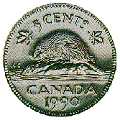

Symbols of Canada
The beaver attained official status as an
emblem of Canada March 24, 1975 .
The maple leaf began to serve as a Canadian symbol as early as 1700 .
The colour of the maple leaves on the arms of Canada was changed from green to red in 1957.
Notes:
Add title using Outline or Slide view.
Copy text from Canada.doc and paste into text box. Separate sentences into paragraphs and adjust bullets appropriately.
Insert pictures - cent2.gif, feuil.gif.
Resize pictures and text box appropriately, formatting text if necessary.

Slide 5

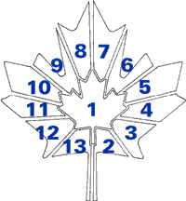
Tartans
Provincial and Territorial Tartans
Maple leaf
Newfoundland
Prince Edward Island
Nova Scotia
New Brunswick
Quebec
Ontario
Manitoba
Saskatchewan
Alberta
British Columbia
Northwest Territories
Yukon
Notes:
Add title using Outline or Slide view.
Copy text from Canada.doc and paste into text box.
Change bulleted list to numbered list.
Insert pictures - tartan_legend.gif, tartans.jpg
Resize and position pictures and text box.
Use Order command to correct problems with overlapping objects.

Slide 6
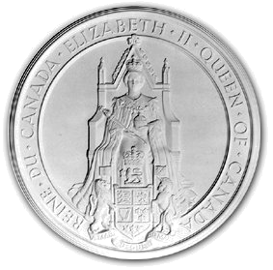
The Great Seal
The Great Seal of Canada is used on all state documents such as proclamations and commissions of:
  cabinet ministers
  Senators
  Judges
  senior government officials.
The seal bears the effigy of Queen Elizabeth II, in her robes, holding the orb and sceptre, and shows her sitting on the coronation chair.
Notes:
Add title using Outline or Slide view.
Copy text from Canada.doc and paste into text box.
Separate sentences into paragraphs for bulleted list. Separate endings of first sentence for second level bullets.
Insert picture - can_seal.jpg
Resize picture and text box, formatting text appropriately.

Slide 7
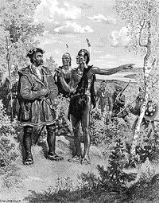
Origin of the Name – Canada
The explorer depicted in the image is Jacques Cartier .
The Huron-Iroquois word for "village" or "settlement” was kanata.
The first use of "Canada" as an official name came in 1791 when the Province of Quebec was divided into the colonies of Upper and Lower Canada.
Notes:
Add title using Outline or Slide view.
Copy text from Canada.doc and paste into text box.
Change bulleted list to numbered list
Insert picture - cartier.gif
Resize and position picture and text box, formatting text appropriately.

Slide 8
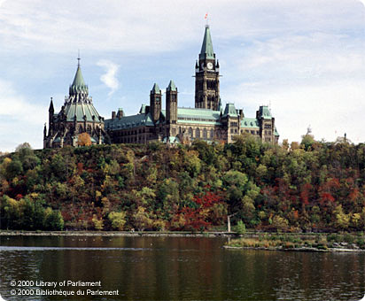
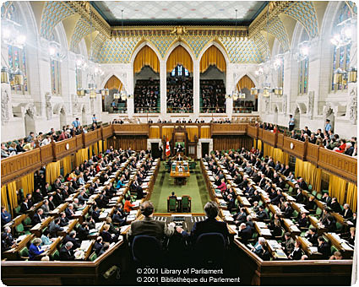
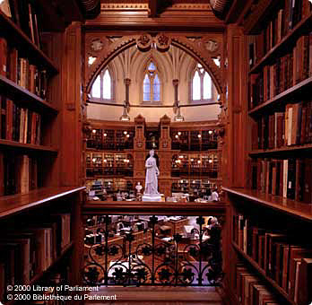
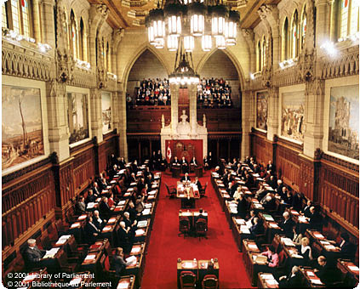
The Parliament Building
The Centre Block
The House of Commons
The Library of Parliament
The Senate Chamber
Notes:
Add title using Outline or Slide view
Insert pictures - centreblock_back.jpg, House of Commons.jpg, Library of Parliament.jpg, Senate Chamber.jpg
Insert text boxes for labels.
Resize and position pictures and text boxes appropriately.

Slide 9
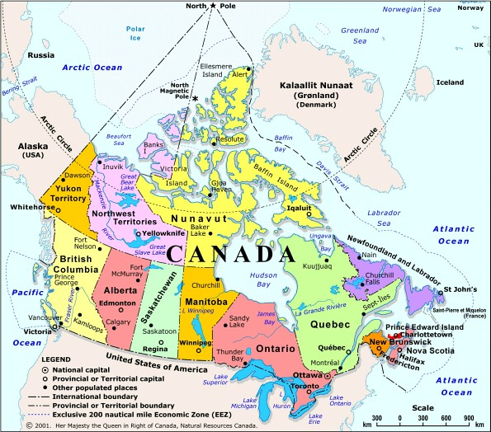
Map of Canada
Notes:
Add title using Outline or Slide view.
Insert picture - canada_map.jpg
Resize and position picture.

Slide 10

References
Canadian Heritage:
  http://www.canadianheritage.gc.ca/index_e.cfm
Canada's Parliament: Symbols and Ceremony:
  http://www.parl.gc.ca/Information/Photos/Index-e.htm
The Atlas of Canada:
  http://atlas.gc.ca/site/english/index.html
Sing for Canada
  http://www.singforcanada.ca/anthem.html
Notes:
Add title using Outline or Slide view.
Copy text from Canada.doc and paste into text box.
Adjust bulleted lists as necessary, formatting text appropriately.
Note that pressing return at the end of a URL creates an active link.

